Slide 1

DIAGNOSIS AND TREATMENT SUGGESTION FOR PARKINSON DISEASES USING ML MODEL
Guide
Team Members
Ramya R
Assistant Professor
Ajay Krishna R
Sabari Ganesh E
Vithyashri V R
Yogesh S
4th Year
Base Paper : Diagnosis and Treatment of Parkinson Disease Melissa J. Armstrong, MD,MSc; MichaelS. Okun, MD ,JAMA February11,2020 Volume323,Number6

Slide 2

TABLE OF CONTENTS
PROBLEM STATEMENT
PROPOSED WORK
KEY FEATURES
TECHNOLOGY STACK
DEVELOPMENT ROADMAP

Slide 3
PROBLEM STATEMENT
Parkinson's disease is a progressive neurodegenerative disorder that affects millions of people worldwide. Early diagnosis and accurate prediction are crucial for timely intervention and effective treatment.
However, traditional diagnostic methods often require multiple clinical visits and can be challenging, especially in the early stages of the disease.
Additionally, there is a need for a more precise and tailored approach to treatment, considering the diverse manifestations of the disease and individual patient characteristics.

Slide 4

PROPOSED SYSTEM
Develop a machine learning model to diagnose Parkinson's disease at an early stage using patient data, including voice recordings, motor skills assessments, and demographic information.
The model aims to improve diagnostic accuracy, reduce the need for frequent clinical visits, and provide personalized treatment suggestions based on the patient's specific condition.
ABOUT US
Elaborate on what you want to discuss.

Slide 5
KEY FEATURES
Personalized Medicine
Medication Management
Therapy Optimization
Monitoring Progress
Early Detection

Slide 6
TECHNOLOGY STACK
PYTHON – Programming Language
Google Colab – IDE
Gradio - GUI

Slide 7


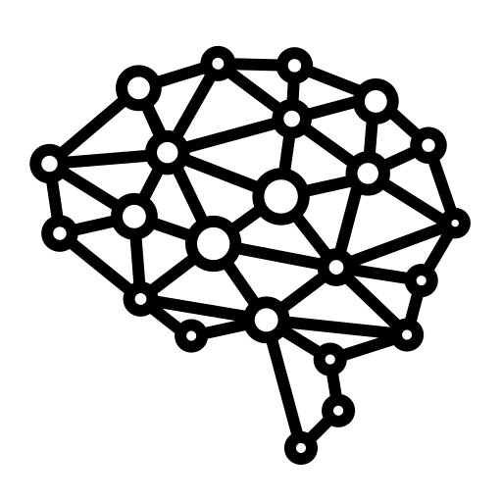



DEVELOPMENT ROADMAP
Data Collection
Data Pre-processing
Model Training
Patient Monitoring
Treatment Suggestion
Diagnosis

Slide 8
THANK YOU!

